Slide 1
Hackathon 2014
The Pingable Pingbots

Slide 2

Internet 2020
More Downloads
Shift to the cloud
Larger Files
4k videos, 100GB
Large Game Files

Slide 3
Benefits of Group Downloads
Faster Downloads.
Reduced bandwidth charges per download.

Slide 4
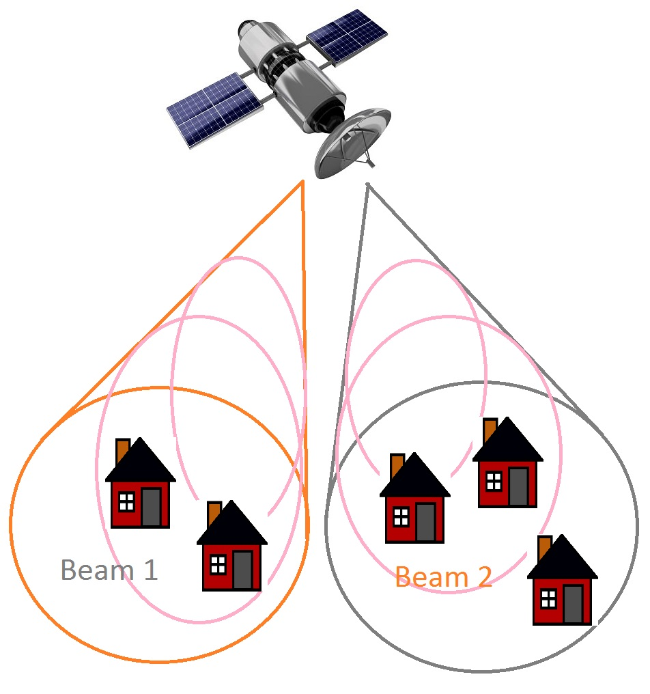
How Group Download Works
Satellite Infrastructure
When the satellite sends a signal to your house, it gets broadcasts to everyone on the beam.
Beams contain 10-20k.

Slide 5
How Group Download Works
Sync Downloads
Multiple customers downloading the same file.
Satellite can increase download speed since its providing a signal for several customers.
It also shares the bandwidth across everyone.

Slide 6
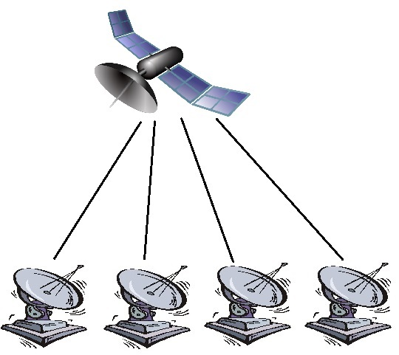
In Action, not Synced
Four people downloading a large file.
Bandwidth Charged: 100GB (Each).
Speed: 12Mb/s.
Time: 18 Hours.

Slide 7
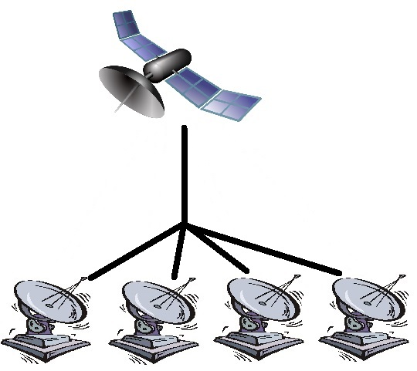
In Action, Synced
Four people downloading a large file.
Bandwidth Charged: 25GB (each).
Speed: 48Mb/s.
Time: 4.5 Hours.

Slide 8
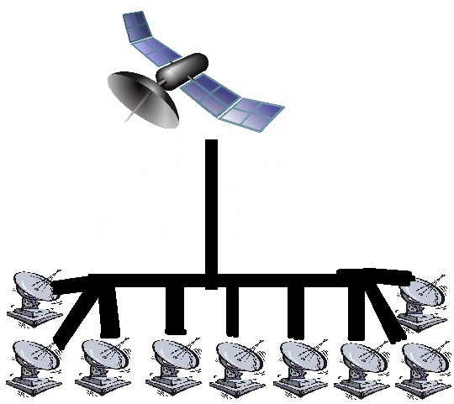
In Action, Synced
Ten people downloading a large file.
Bandwidth Charged: 10GB (each).
Speed: 120Mb/s.
Time: 2 Hours.

Slide 9
Design
An easy interface that will allow users to connect:
Submit requests for specific files.
Browse categories and vote for different downloads.
Enjoy more and faster downloads.

Slide 10
Benefits
Benefits are optimized for small group sizes
People vs Possible Benefit:
2=50%
5=80%
10=90%

Slide 11
Benefits

Slide 12
Group Size
Relative Bandwidth vs Group Size

Slide 13
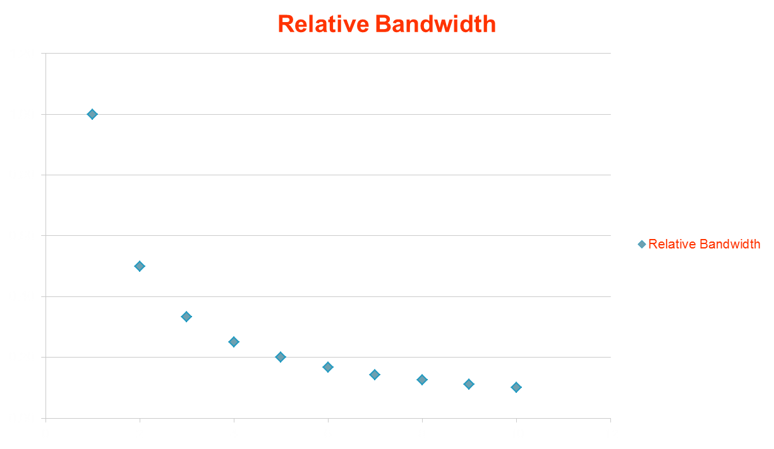
Benefits of group Downloading
Benefits are optimized for small group sizes
People vs Possible Benefit:
2=50%
5=80%
10=90%

Slide 14
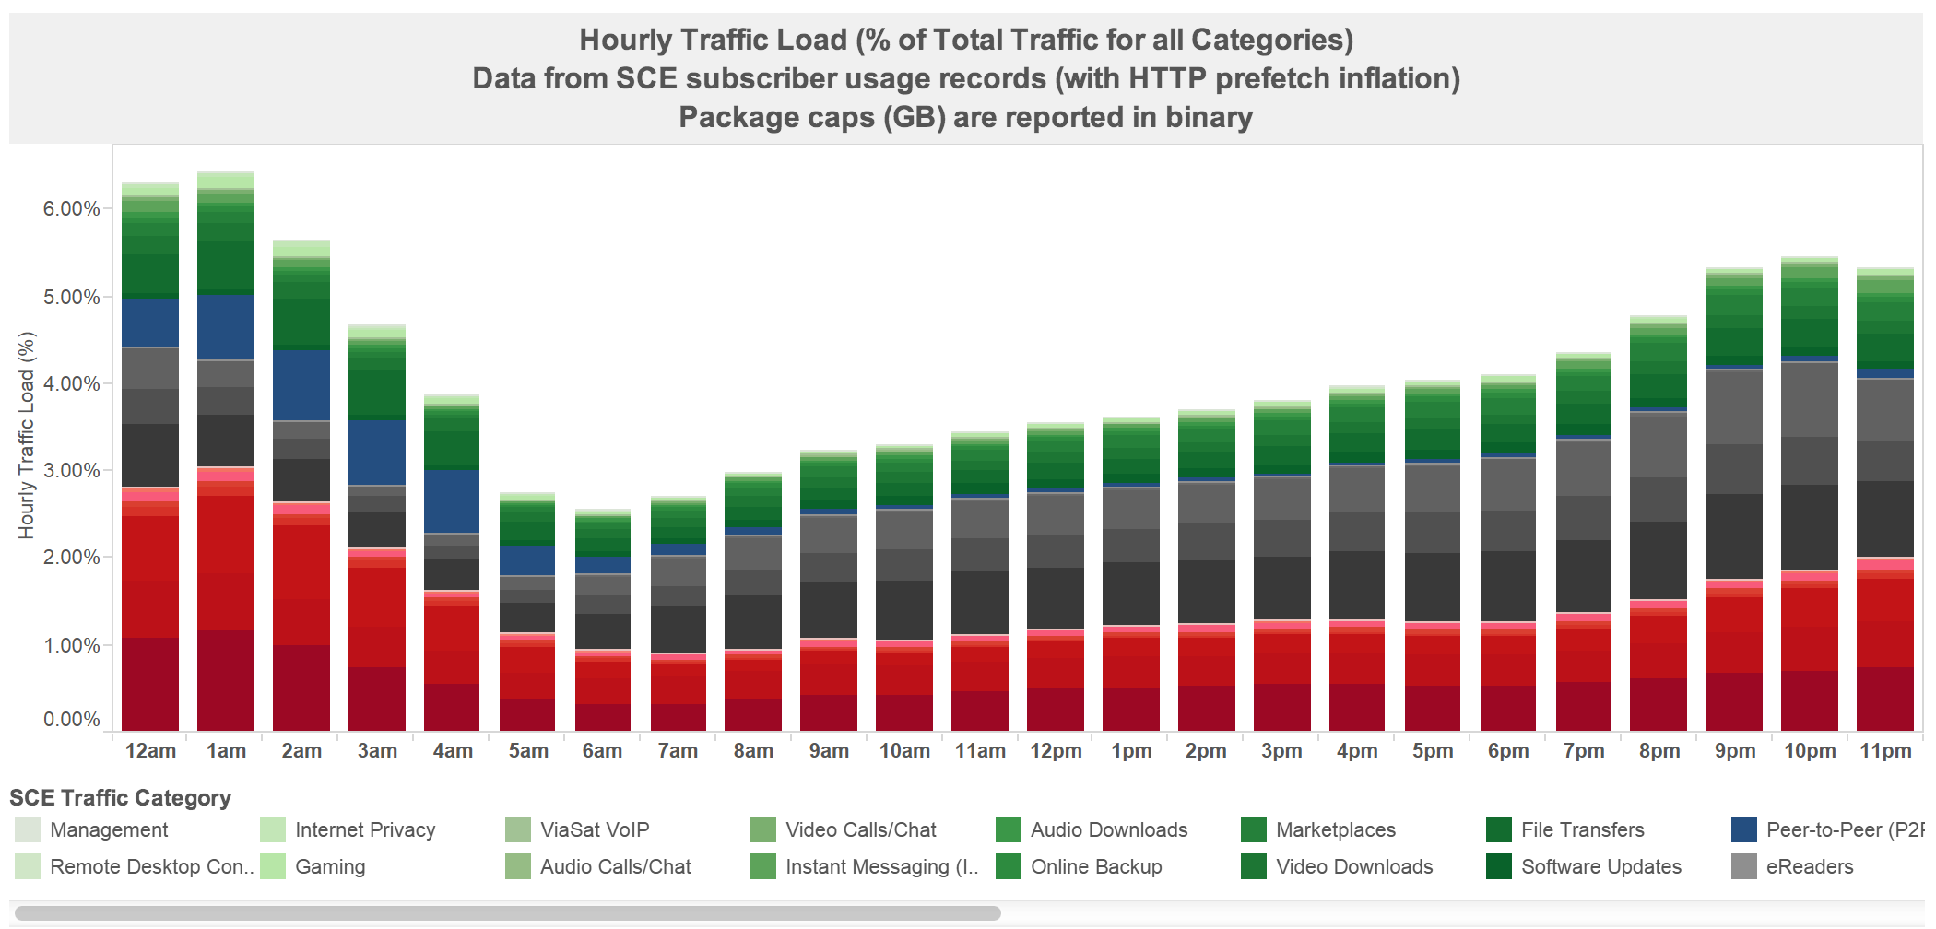
What’s next

Slide 15
